Slide 1
CI/CD PIPELINE
-20PW39
-20PW40

Slide 2
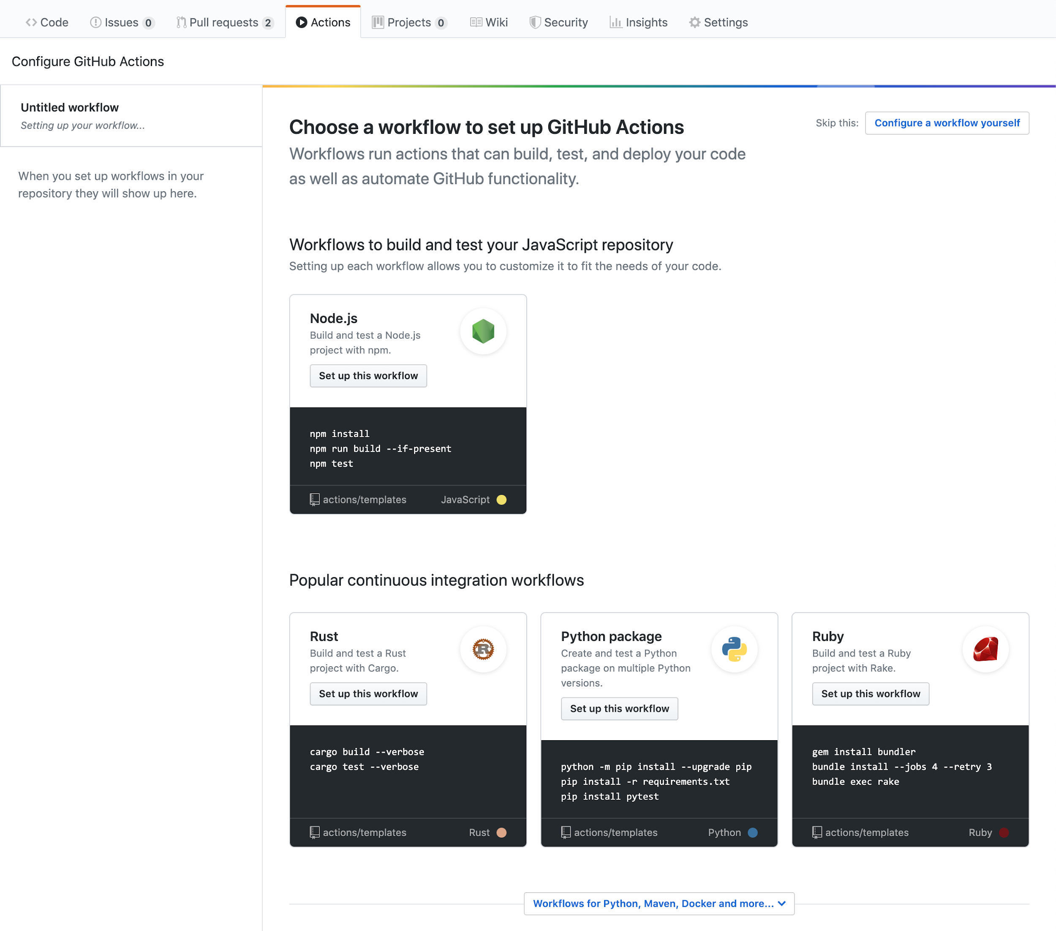
Continuous Integration
Frequently committing code to a shared repo.
Continuously build and test code so that it doesn’t introduce errors.
Building and testing your code requires a server. You can build and test updates locally before pushing code to a repository, or you can use a CI server that checks for new code commits in a repository
Notes:
You can configure your CI workflow to run when a GitHub event occurs (for example, when new code is pushed to your repository), on a set schedule, or when an external event occurs using the repository dispatch webhook.
GitHub runs your CI tests and provides the results of each test in the pull request, so you can see whether the change in your branch introduces an error. When all CI tests in a workflow pass, the changes you pushed are ready to be reviewed by a team member or merged. When a test fails, one of your changes may have caused the failure.
When you set up CI in your repository, GitHub analyzes the code in your repository and recommends CI workflows based on the language and framework in your repository. For example, if you use Node.js

Slide 3
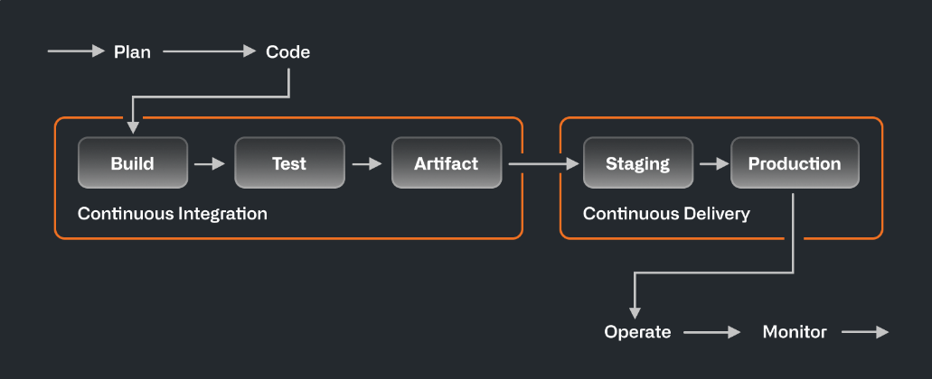
Continuous Delivery
Continuous delivery (CD) automatically delivers code changes to production-ready environments for approval.

Slide 4
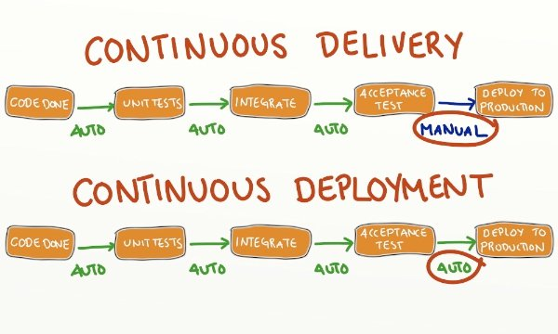
Continuous Delivery v/s Deployment???
In a CI/CD pipeline that uses continuous delivery, automation pauses when developers push to production.
Continuous deployment automates the entire release process.
Notes:
When someone says CI/CD, the “CD” they’re referring to is usually continuous delivery, not continuous deployment. What’s the difference? In a CI/CD pipeline that uses continuous delivery, automation pauses when developers push to production. A human—your operations, security, or compliance team—still needs to manually sign off before final release, adding more delays. On the other hand, continuous deployment automates the entire release process. Code changes are deployed to customers as soon as they pass all the required tests.

Slide 5
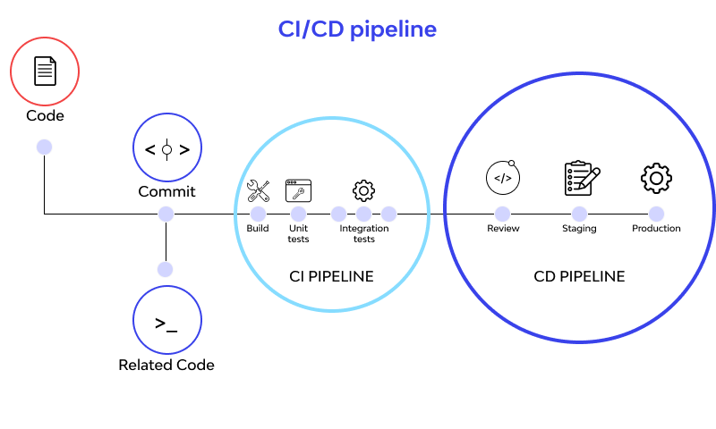
Notes:
A CI/CD pipeline causes you automation steps in your product conveyance process, for example, starting code constructs, running mechanized tests, and sending to an organizing or creation condition. Robotized pipelines evacuate manual mistakes, give institutionalized improvement criticism circles and empower quick item emphasis

Slide 6
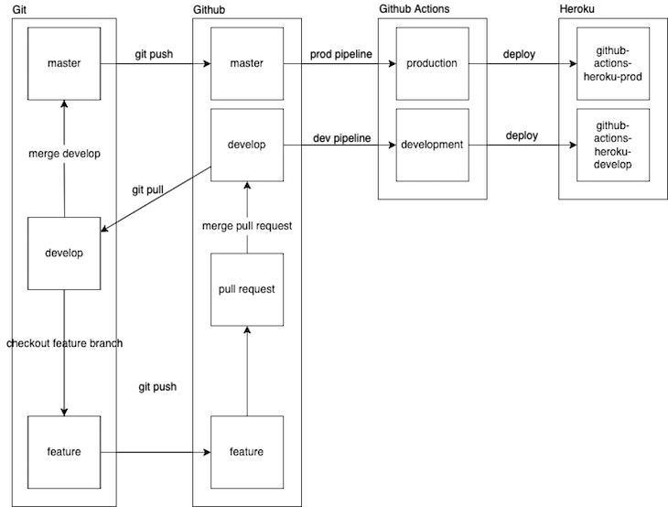
GitHub and CI/CD
/Netlify
Notes:
We’ll have one GitHub repository with two branches, main and develop. We’ll also make a new feature branch from the develop branch, where we’ll develop a new feature and push those changes to its own feature. Then, we’ll create a pull request against the develop branch on GitHub.We’ll also have two CI/CD yml files for configuration, development and production. The development file is set up to trigger the CI/CD pipeline and deploy our changes to the development environment when we successfully merge a pull request into the develop branch. The production.yml file is set up to trigger a CI/CD pipeline for the production environment when we pull the latest changes from the develop branch, merge develop into main, and finally push those changes to the remote main branch.

Slide 7
GitHub Actions

Slide 8
Overview
GitHub Actions is a continuous integration and continuous delivery (CI/CD) platform that allows you to automate your build, test, and deployment pipeline.
You can create workflows that build and test every pull request to your repository, or deploy merged pull requests to production.
For example, you can run a workflow to automatically add the appropriate labels whenever someone creates a new issue in your repository.

Slide 9
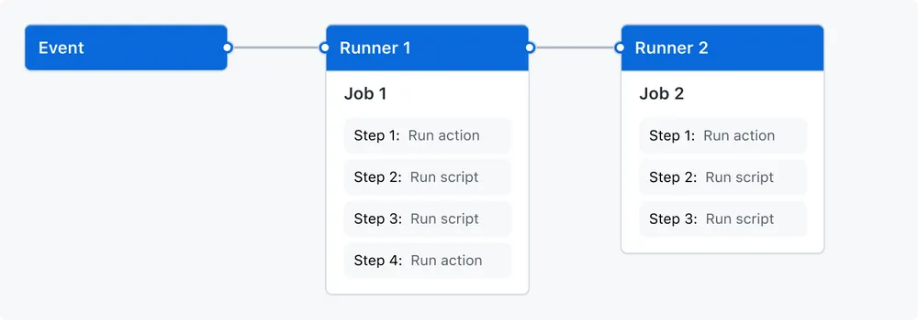

Slide 10
Workflows
A workflow is a configurable automated process that will run one or more jobs. Workflows are defined by a YAML file checked in to your repository and will run when triggered by an event in your repository
Workflows are defined in the .github/workflows directory in a repository, and a repository can have multiple workflows, each of which can perform a different set of tasks.
For example, you can have one workflow to build and test pull requests, another workflow to deploy your application every time a release is created, and still another workflow that adds a label every time someone opens a new issue.

Slide 11
Events
An event is a specific activity in a repository that triggers a workflow run.
Workflow triggers are events that cause a workflow to run.
Runs your workflow when activity related to a check run occurs. A check run is an individual test that is part of a check suite.

Slide 12
Jobs
A job is a set of steps in a workflow that is executed on the same runner. Each step is either a shell script that will be executed or an action that will be run
Steps are executed in order and are dependent on each other. Since each step is executed on the same runner, you can share data from one step to another.
For example, you can have a step that builds your application followed by a step that tests the application that was built.
You can configure a job's dependencies with other jobs; When a job takes a dependency on another job, it will wait for the dependent job to complete before it can run
For example, you may have multiple build jobs for different architectures that have no dependencies, and a packaging job that is dependent on those jobs. The build jobs will run in parallel, and when they have all completed successfully, the packaging job will run.

Slide 13
Actions
An action is a custom application for the GitHub Actions platform that performs a complex but frequently repeated task.
Use an action to help reduce the amount of repetitive code that you write in your workflow files.
An action can pull your git repository from GitHub, set up the correct toolchain for your build environment, or set up the authentication to your cloud provider.
You can write your own actions, or you can find actions to use in your workflows in the GitHub Marketplace.

Slide 14
Runners
A runner is a server that runs your workflows when they're triggered. Each runner can run a single job at a time.
Each workflow run executes in a fresh, newly-provisioned virtual machine.
When a workflow is triggered, GitHub selects a runner from a pool of available runners and assigns it to the job.
When a job is assigned to a runner, the runner checks out the code for the repository and executes the steps defined in the job.

